Slide 1
Designing Private Forums
Theodor Lukin Yelin

Slide 2
Acknowledgements
Albert Kwon
PRIMES Program
Friends and Family

Slide 3
Motivation and Background

Slide 4
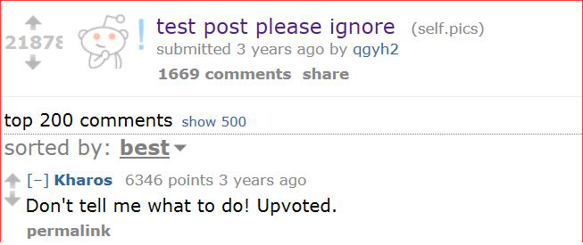
Examples of forums
Reddit, Facebook
Title/Content
Views/Votes

Slide 5
What is a forum?

Slide 6
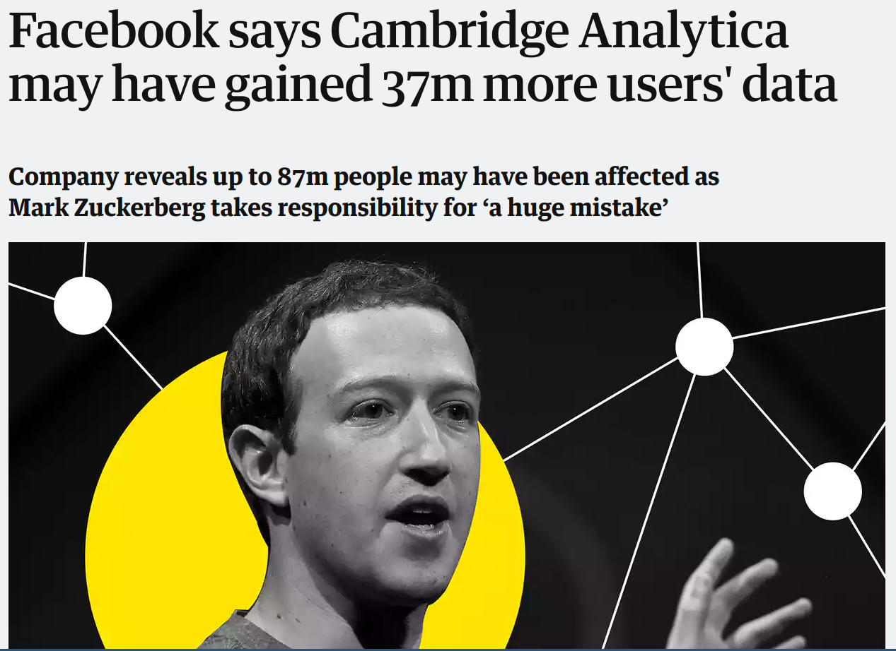
Lack of privacy on existing forums
Voting patterns are immediately available to the servers
Can create strong profiles of people based on patterns

Slide 7
Threat model and goals
Enable accurate aggregate statistics on the votes without revealing individual votings to the adversary

Slide 8
Differential privacy
Goal: Maximize the accuracy of queries from databases, while minimizing the chances of identifying individual records
Add noise (randomness) to database (votes)
3 main mechanisms
Randomized Responses
Noisy database
Noisy answers to queries

Slide 9
Design

Slide 10
Voting privacy
Value of the vote
What the user votes on

Slide 11
Hiding values of votes
H
Respond with V
p
H
Respond with up
q
User vote V
T
Respond with down
T
Notes:
Mention plausible denyability here

Slide 12
Properties of randomized voting
Estimating true count
Observed = TrueCount ∗ p + (1 - p) ∗ q
TrueCount = (Observed - (1-p)∗q) / p
Quantifying Privacy
H = Pr[R=Up | T=Up] / Pr[R=Up | T=Down]
Smaller H = more private

Slide 13
Accuracy of votes - 95% confidence intervals
Computed 95% confidence intervals
p=0.5, q=0.5
Votes | 100 | 1000 | 10000 | 100000 | 1000000 | 10000000
Actual | 49 | 483 | 5029 | 50112 | 500260 | 5000219
Interval Size | 9 | 27 | 97 | 339 | 1164 | 3167
Interval Size (%) | 8.91 | 2.68 | 0.97 | 0.34 | 0.12 | 0.03
p=0.75, q=0.5
Votes | 100 | 1000 | 10000 | 100000 | 1000000 | 10000000
Actual | 50 | 501 | 4993 | 49970 | 499995 | 5000120
Interval Size | 7 | 18 | 55 | 165 | 614 | 1664
Interval Size (%) | 6.97 | 1.85 | 0.55 | 0.16 | 0.06 | 0.02

Slide 14
Hiding values of votes
H
Send V to server
p
H
Send up vote
q
User vote V
T
Send down vote
T

Slide 15
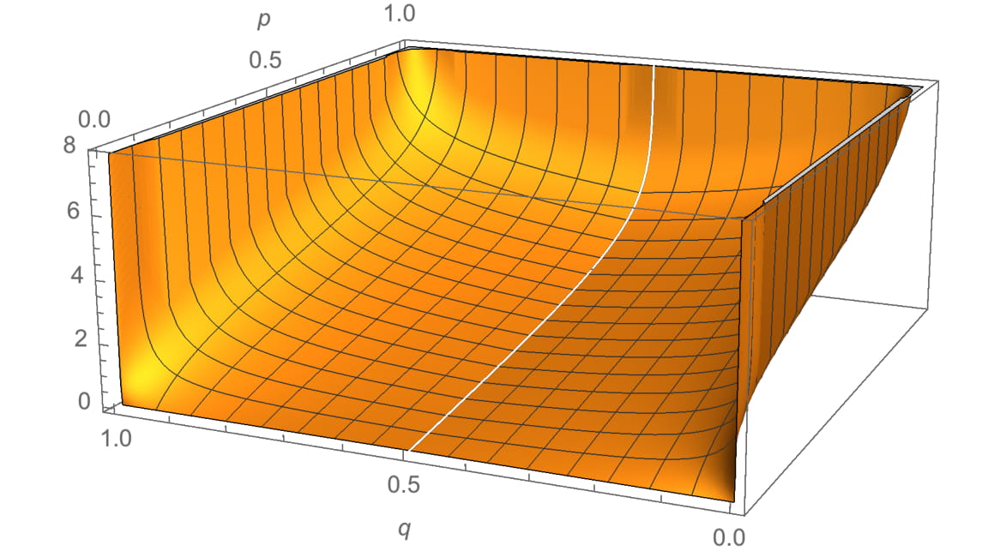
Trading off accuracy and privacy
Privacy (H) as function of p and q
Accuracy and Privacy are inversely correlated
Choose tradeoff point based on needs of system

Slide 16
Conclusions and Outlook
Differential privacy is viable
Needs ~100 votes to be accurate
Hiding what user votes on remains inefficient
Working on full prototype evaluation
Notes:
Mention that we have what to vote on system, but that it remains inefficient

